Slide 1
WELCOME

Slide 2
NEXT HIKE SOLUTIONS
Bike Rental data analysis
Understanding the effect of weather and time on bike usage
By- Shweta Singh

Slide 3
Objectives
Goal:
To analyze how factors like weather and time affect bike rentals.
To find trends that can help improve bike-sharing operations and marketing.

Slide 4
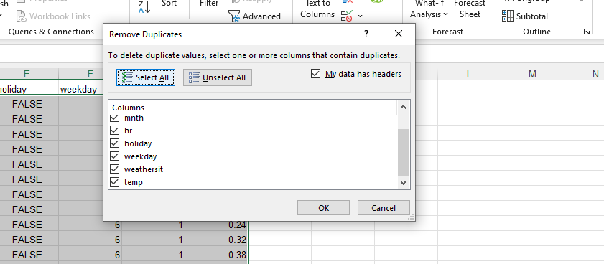
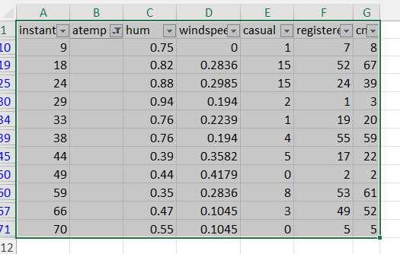
Data Cleaning & Preparation
Removed missing values and duplicates
I have removed it using Data tab → click Filter. Then I have unchecked everything and selected only blank option. Missing values were only in atemp column in dataset 2.
Then I have removed Filter.
Merged datasets on common key like date, hour

Slide 5
Added new column
Added new column – Hour group, Weather type
Hour group are categorized on the basis of hr column – 0-5 ( Night) , 6-11(morning) , 12-17 (afternoon) , 18-23 (evening).
Formula = My hour column is in B=IF(B28="","",
IF(AND(B28>=6,B28<=11),"Morning",
IF(AND(B28>=12,B28<=17),"Afternoon",
IF(AND(B28>=18,B28<=23),"Evening","Night"))))
For weather type on the basis of weather sit = =IF(D2=1,"Clear",
IF(D2=2,"Mist/Cloudy",
IF(D2=3,"Light Snow/Rain",
IF(D2=4,"Heavy Rain","Unknown"))))

Slide 6
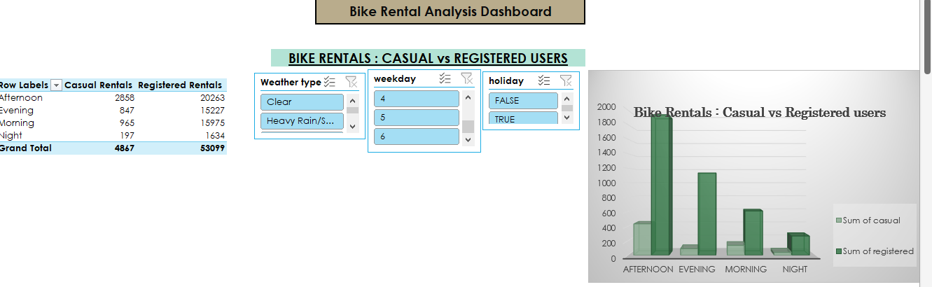
Pivot table and Charts
Casual vs Registered Rentals on the basis of time hour, weather and weekdays :

Slide 7
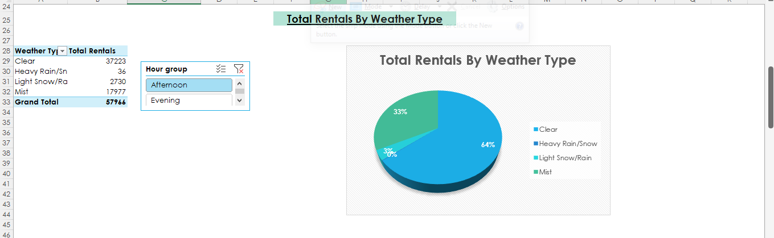
Rentals by Weather type

Slide 8
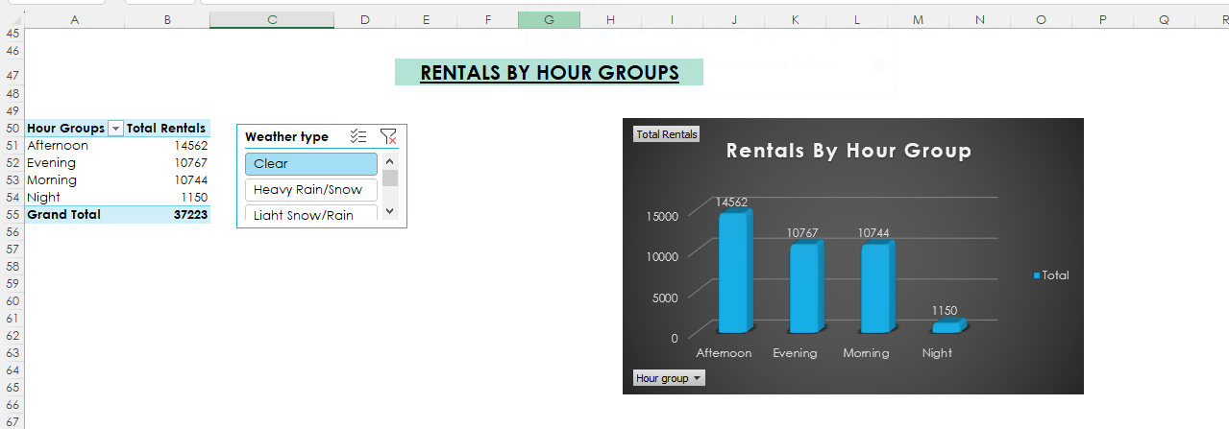
Rentals by hour group

Slide 9
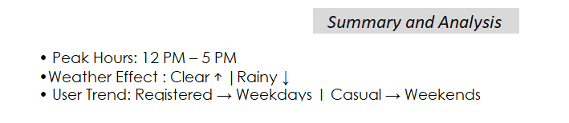
Key Insights

Slide 10
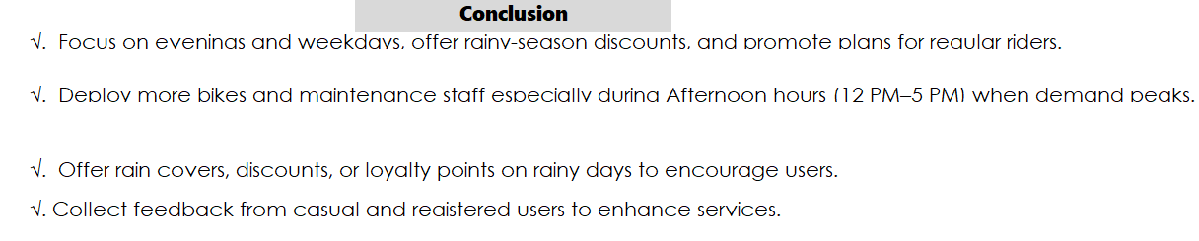
Conclusions

Slide 11
Thank You

